Slide 1
ADAPTERS
Capgemini, India

Slide 2
Table of contents
1
What is Adapter ?
Benefits of Adapter
2
List of Adapters
3
SFTP Adapter
4
MAIL Adapter
5
ODATA Adapter
6
HTTP Adapter
7
HTTPS Adapter
5
PROCESSDIRECT Adapter
6
SOAP Adapter
7

Slide 3
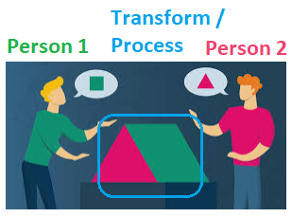
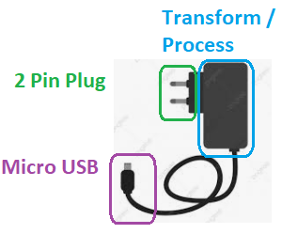
What is Adapter?
Simple Definition Adapter establishes the communication between two applications.
Adapter helps to specify what technical protocols are preferred by Sender OR Receiver.
Any Middleware System’s strength depends on an availability of multiple Adapters so it can talk to many Systems / Applications.
SAP CPI offers several adapters to connect runtime engines to SAP legacy systems & external systems. Many adapters have two communication channels — one for the sender and the other for the receiver. The Adapter Type depends on the type of scenario/communication that need to be established between two different systems.
Simple Non-Technical & Generic Example 1 – Google Translator
Two person with different language when talking will need Google Translator to exchange info. So, two people are like two systems
Google Translator receipts Msg in Lang 1 from one person, Processes it, Transforms it to Lang 2 for another person.
Lang 1 is like Adapter for one Person and Lang 2 is Adapter for another Person.
Google Translator has both Adapters and acts as Integration Middleware between them.
Simple Non-Technical & Generic Example 2 – Mobile Charger
Mobile Charger takes output of Electricity Line with 2 Pin Top Plug at 240Vs and converts it to Micro USB compatibility for Mobile.
So, 2 Pin Top Plug is one side Adapter & Micro USB Connector is Mobile side Adapter and Entire Circuit within Charger acts as Integration Middleware that receipts processes & transforms signal from High Level into Micro USB level compatibility.

Slide 4
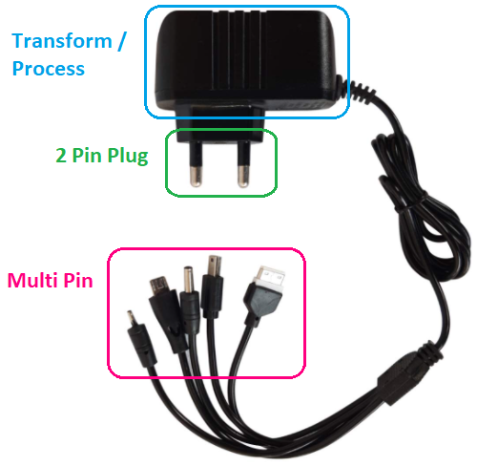
Benefits of Adapters
Reusability – Same end to end Integration can be reused for many applications / systems talking to each other.
Simple Example – Google Translator can be used by Person 1 English-speaking Person to communicate with Person 2 French speaking person.
Person 1 English ←→ Person 2 French
SAP Example – System 1 SOAP → System 2 SFTP Integration
Compatibility – With Multiple Adapters in one Middleware System, Integrations can be designed to use Adapter that is compatible with different systems.
Simple Example – Person 1 knowing English can use Google Translator to communicate with two different people in their compatible languages i.e. Person 2 French speaking and Person 3 German speaking.
Person 1 English ←→ Person 2 French
Person 1 English ←→ Person 3 German
SAP Example – System 1 SOAP → System 2 SFTP Integration
System 1 SOAP → System 3 API Integration
System 1 ODATA ← System 4 SOAP Integration

Slide 5
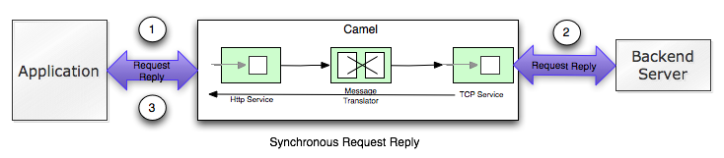
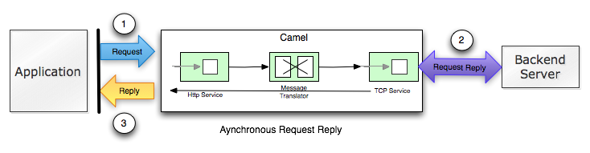
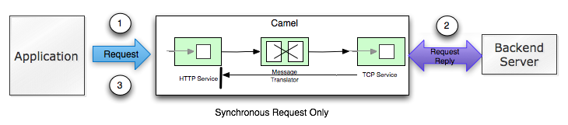

Sync & Async Messages
Sync Request-Reply – A synchronous exchange is defined as the caller sends a message and waits until it’s complete before continuing.
Async Request-Reply – The asynchronous version is where the caller sends a message to an Endpoint and then returns immediately back to the caller. The message, however, is processed in another thread, the asynchronous thread.
Sync Request Only – Client will send the message until it is completely processed by Receiver. Client will not other operation and will wait to hear for any errors.
Async Request Only – the client will not wait for the processing of the message to complete & can immediately continue doing other work while the message is being routed and processed in Camel.

Slide 6
List of Adapters
Sender Adapters
AMQP
Ariba
AS4
FTP
HTTPS
IDOC
Mail
OData
Process Direct
SFTP
SOAP
SuccessFactors
XI
Receiver Adapters
AMQP
Ariba
AS4
Elster
Facebook
FTP
OData
HTTP
IDOC
JDBC
LDAP
Mail
ODC
Open Connectors
Process Direct
RFC
SFTP
SOAP
SuccessFactors
Twitter
XI

Slide 7
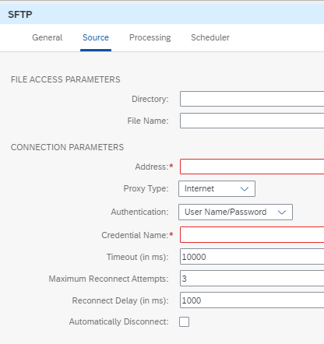
SFTP Adapter
Sender SFTP Adapter
Cloud Platform Integration provides SFTP adapter that enables you to poll the messages of specific folder in their SFTP server using sender SFTP or to place the files using receiver SFTP Adapter.
Sender SFTP adapter that enables you to poll the messages of specific folder in their SFTP server.
Directory: Directory name which is to be polled on the SFTP server.
File Name: File name which needs to be picked by the adapter.
Address: This is mandatory field, connecting server address to be mentioned here.
Credential Name: Mention the name saved in the security material.
Timeout, maximum reconnects maintain default settings.
Processing and scheduling have to change depending upon the requirement.

Slide 8
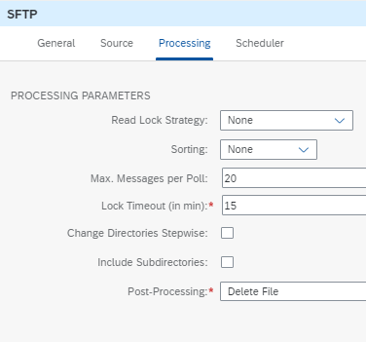
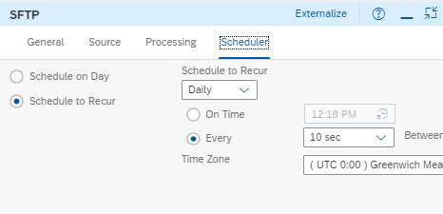
Configuration: Sender SFTP Adapter

Slide 9
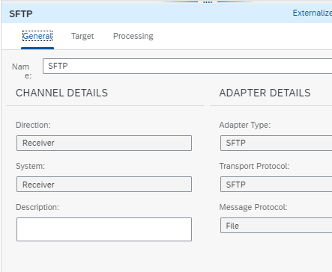
Receiver SFTP Adapter
Receiver SFTP adapter that enables you to place the files in their SFTP folder.

Slide 10
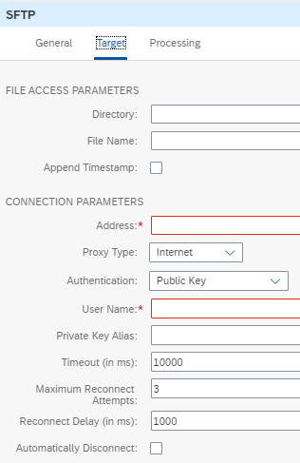
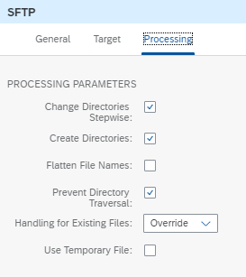
Configurations: Receiver SFTP Adapter Same as sender settings mention the directory file needs to be placed, file name, address of SFTP server and Authentication.
Timeout, maximum reconnects and Advanced maintain default settings.
Processing must change depending upon the requirement.
Use Case: When we want to pick the files form the 3rd party server or to place the files from 3rd party server we will use this adapter in flow.

Slide 11
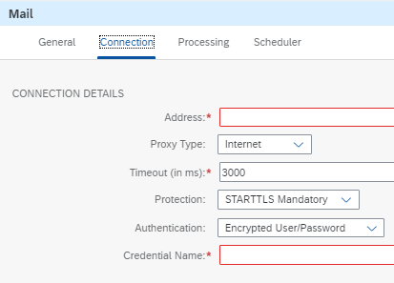
MAIL Adapter: Sender Mail Adapter
Sender Mail adapter that enables you to poll mails from specified mail inbox. Using this adapter can download e-mails using IMAP or POP3 protocol and access the e-mail body content as well as attachments. Below are few differences between POP3 and IMAP protocol.
Use Case: When we want to fetch the data from the mail or sent to the mails we use this adapter in the flows.
POP3 – Post Office Protocol | IMAP – Internet Messaging Access Protocol
You can use only one computer to check your email (no other devices) | You can use multiple computers and devices to check your email
Your mails are stored on the computer that you use | Your mails are stored on the server
Sent mail is stored locally on your PC, not on a mail server | Sent mail stays on the server so you can see it from any device.

Slide 12
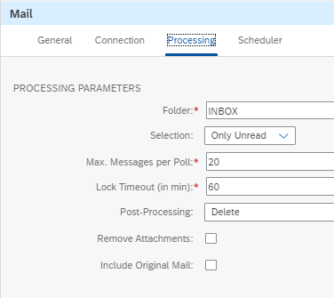
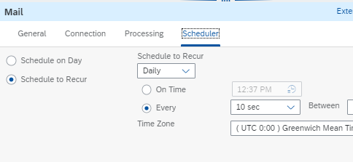
Configuration: Sender Mail Adapter

Slide 13
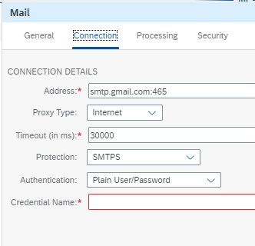
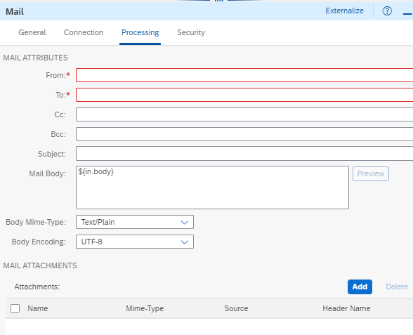
Receiver Mail Adapter
Cloud Platform Integration provides Receiver Mail adapter that enables you to send mail to desired mail address. This adapter uses SMTP as a transport protocol default
Below address is used to connect the Gmail. To connect with outlook or other mail address its different.

Slide 14
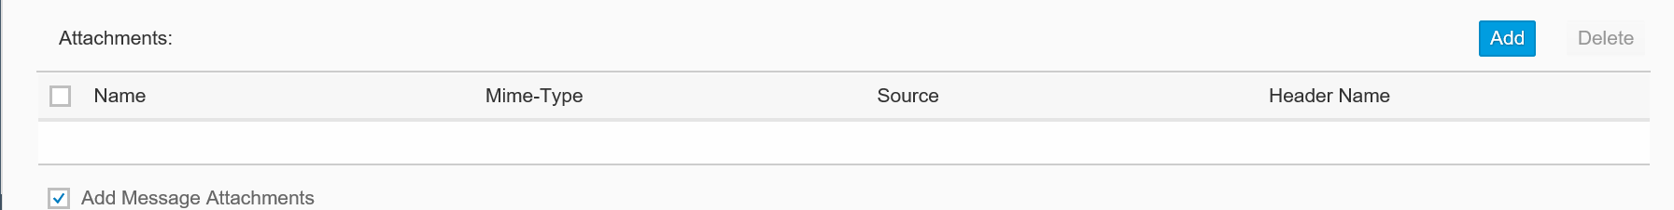
Configurations: Receiver Mail Adapter
From: Its mandatory field but a dummy mail id can be provided over here. As there is no validation done on the mail credentials deployed as an artifact with the address provided in the From parameter.
To: It’s mandatory, a valid mail address need to be provided here. You can pass this parameter through headers or property of content modifier (ex: ${header.<Name>} or ${property.<Name>}).
Mail Body: Specifies the text of an e-mail message.
Body MIME-Type: Specifies the type of the message body. This type determines how the message is displayed by different user agents.
Body Encoding: Specifies the character encoding (character set) of the message body. The content of the input message will be converted to this encoding, and any character that is not available will be replaced with a question mark (‘?’). To ensure that data is passed unmodified, select a Unicode encoding, for example, UTF-8.
Add Message Attachments: Select this option to add all attachments contained in the message exchange to the e-mail.
Name(under Attachments): Specifies the file name of the attachment.
MIME Type(under Attachments): The Multipurpose Internet Mail Extensions (MIME) type specifies the data format of the e-mail. You can select from the following MIME types: Text/Plain, Text/CSV, Text/HTML, Application/XML, Application/JSON, and Application/Octet-Stream.
Source: Specifies the source of the data. This can be either Body, meaning the body of the input message, or Header, meaning a header of the input message.
Header Name: If the source is Header, this parameter specifies the name of the header that is attached.
Add Message Attachments: Select this option to add all attachments contained in the message exchange to the e-mail.

Slide 15
ODATA ADAPTER
Receiver OData Adapter
Odata protocol is an open standard protocol that allows service providers to define access to their resources in a standardized manner.
The service definition is available via the service metadata document (EDMX).
OData allows resources (Entity Sets) to be identified using Uniform Resource Identifiers (URIs) and defined in an abstract data model.
E.g. If the user wants to access Employee with primary key as 1, the details of the URI would be http://<server name>/<service name>/Employees(1) with the HTTP GET operation
The data format for exchange is ATOM XML or JSON.
What makes the OData protocol very flexible is the availability of associations which defines the relationship between Entity Sets.
For example, Let us say when retrieving Employees you would also like to get information about their HR and if this (HR) is defined as an association then this is possible in one single call and also directly by modifying the URI appropriately.
In CPI you can connect to any OData service provider and perform the required operation required for your integration scenario.
When data is fetched from the OData Service either in ATOM-XML or JSON format, the Adapter automatically converts this to XML and the payload can be used with any of the steps (e.g. mapping) available in the platform.
Similarly, when sending data back to the OData service via the PUT or POST operation, the data is converted back from XML to JSON or ATOM-XML format automatically by the Adapter.

Slide 16
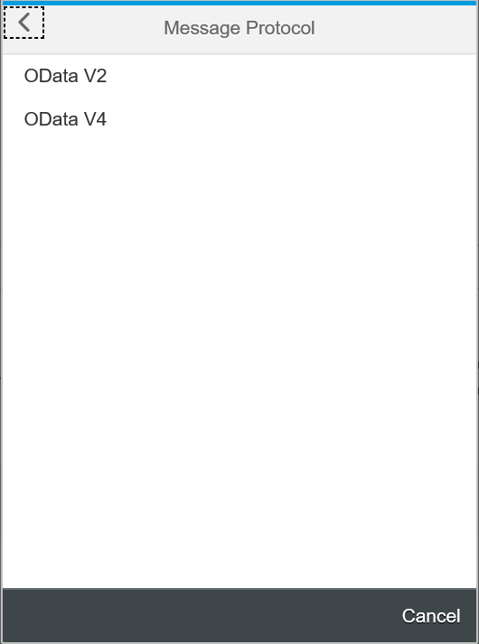
Configurations: Receiver OData Adapter The OData Adapter in CPI supports the v2 and v4 version of OData Protocol.
OData 2 was a Microsoft Open Specification Promise (OSP), while OData 4 is approved by OASIS and ISO.
In OData 2, specification, payload had to be retrieved in both XML and JSON formats.
In OData 4, XML is optional.
So, Data Pipeline today supports both XML and JSON in OData 2 and only JSON in OData 4.
But, the metadata can still be retrieved in the XML format in OData 4.

Slide 17
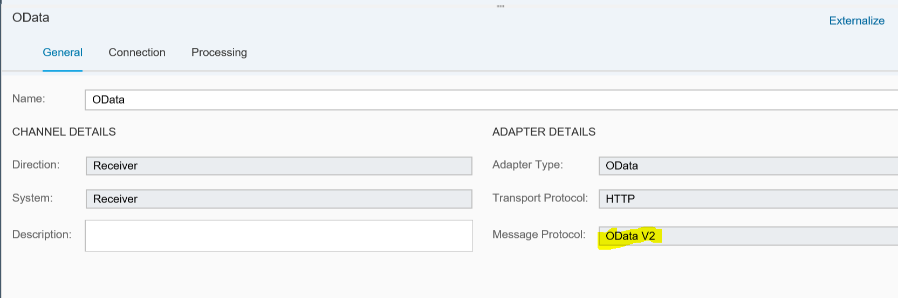
Configurations: Receiver OData Adapter
Here it was v2 as message protocol.

Slide 18
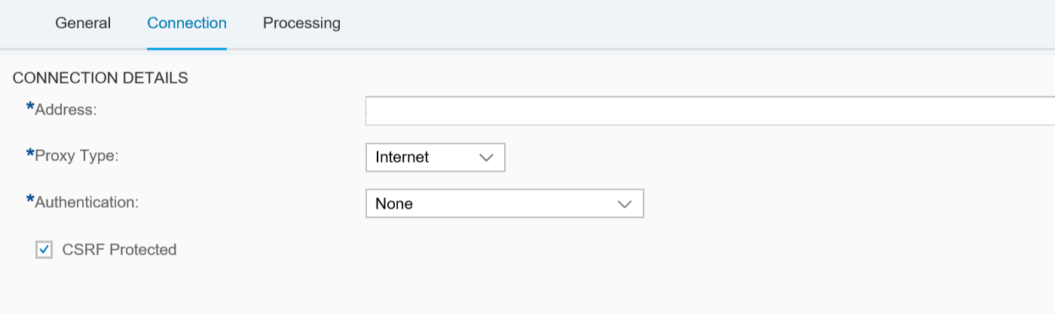
Configurations: Receiver OData Adapter
Address: URL need to connect via OData protocol.
Operation: GET/POST/PUT/DELETE etc..
GET- Get data from the server.
POST- Create the data on the server.
PUT- Update data on the server for existing resource.
DELETE- Delete the data on the server.
Resource path: Entity name from you are fetching the data.
Query: Query with field names from the entity if any where clause.
Custom query: optional
Content type: Atom(XML)/Json

Slide 19
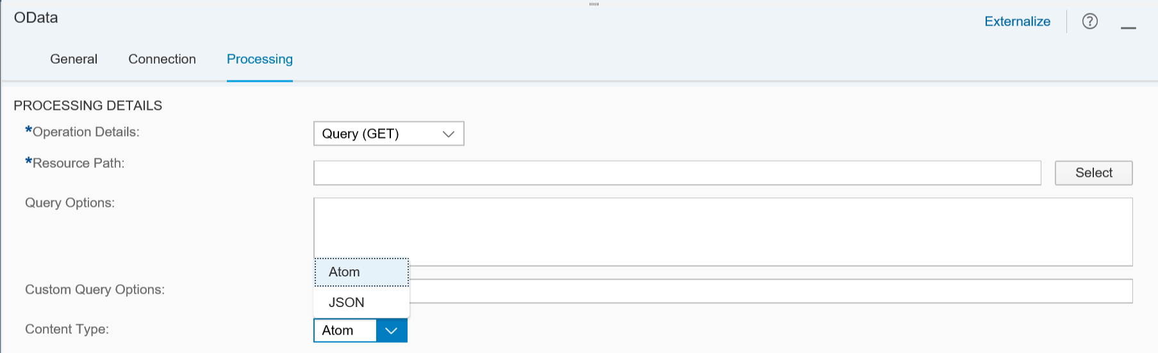
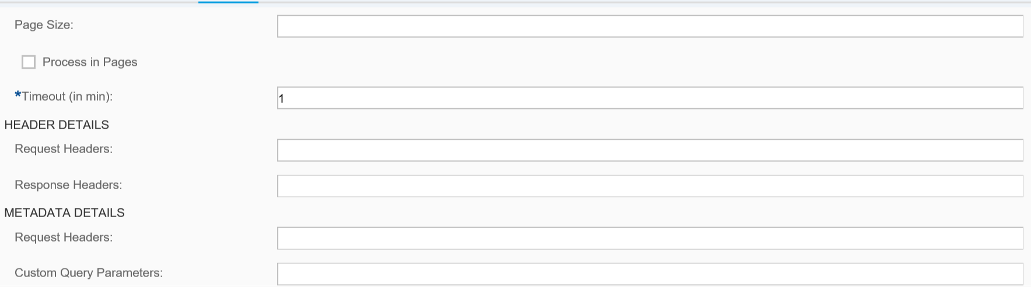
Configurations: Receiver OData Adapter
Page size: This allows you to specify a Page Size. This feature is useful in case the OData Service that you are connecting to has problems with large payload size. Using Page Size the Adapter fetches data in smaller chunks from the OData Service.
Header/Metadata details are optional. If any request headers we need to mention.
Use Case: When we are trying to fetch the data through webservice from the 3rd party system, if the 3rd party system supports Odata protocol then we use this in the flow.
:)

Slide 20
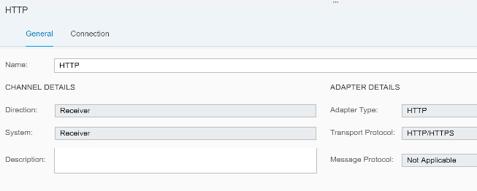
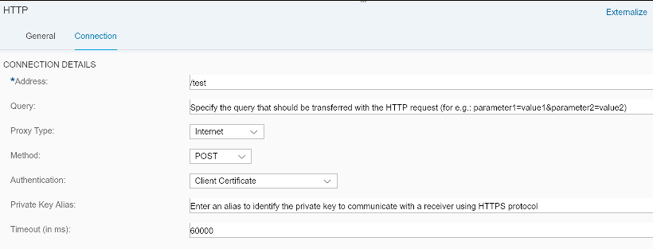
HTTP Adapter: Receiver HTTP Adapter
The HTTP Sender Adapter is used to communicate with receiver systems using HTTP message protocol.
Address: URL of the system to be connected to. Query: It is the query string to be sent with the HTTP request.
E.g.: Producer = Unilever Ltd. Item = Nick&Nicka So, the query becomes, Producer=Unilever+Ltd.&Item=Nick%26Nicka Proxy Type: The type of proxy that you are using to connect to the target system: • Internet: If connection is with a cloud system. • On-Premise: If connection is with an on-premise system. • Manual: Manually Proxy Host and Proxy Port can be assigned.

Slide 21
Configuration: Receiver HTTP Adapter
Method: Action of the HTTP request. • POST: Requests that the receiver accepts the data enclosed in the request body. • Delete: Requests that the origin server delete the resource identified by the Request-URl • Dynamic: The method is determined dynamically by reading a value from a message header or property such as ${header.abc} or ${property.abc} during runtime. • GET: Sends a GET request to the receiver. • HEAD: Sends a HEAD request which is similar to a GET request but does not return a message body. • PUT: Updates or creates the enclosed data on the receiver side. • TRACE: Sends a TRACE request to the receiver that sends back the message to the caller.
Private Key Alias: It enables the system to fetch the private key from keystore for authentication.
Authentication: Defines how the tenant (as the HTTP client) will authenticate itself against the receiver. • None: No Authentication. • Basic: The tenant authenticates itself against the receiver using user credentials (user name and password) provided that user credentials are specified in a Basic Authentication artifact and deployed on the related tenant. • Client Certificate: The tenant authenticates itself against the receiver using a client certificate. Timeout (in ms): Maximum time the tenant waits for a response. Default value is 60000 milliseconds (1 minute). Use Case: In scenarios where it is required to send an HTTP request to fetch some information from a certain URL of a system, this adapter can be used. E.g.: An HTTP request can be sent to the CPI tenant to fetch the error logs of the failed messages. The response of HTTP request for error info can be then stored as exchange property and Message content is retrieved in Message Body.

Slide 22
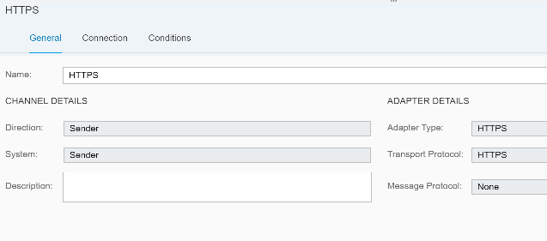
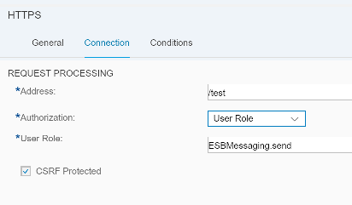
Sender HTTPS Adapter:
The HTTPS Sender Adapter is used to communicate with receiver systems using HTTPS message protocol.
Address: It is the URL of the HTTP system to connect to. E.g.: /test.
Authorization: It specifies the authorization option for the sender.
There are two options:
Client Certificate (Sender authorization is checked on the tenant by evaluating the subject/issuer distinguished name (DN) of the certificate)
User Role (Sender authorization is checked based on roles defined on the tenant for the user associated with the inbound request.)

Slide 23
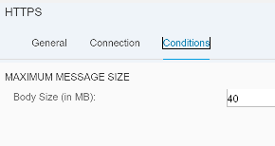
Configuration: Sender HTTPS Adapter
CSRF Protected: This option prevents Cross-Site Request Forgery (CSRF), which is a malicious online attack. Such attacks exposes user content without their authorization.
Condition Details:
Body Size (in MB): It allows you to set a maximum size limit for processing inbound messages. The inbound messages which exceed the limit are rejected.
Use Case: If there is a scenario where in some bank transactions or other sensitive data has to be sent, HTTPS adapter can be used because HTTPS creates secure tunnel while sending the data.

Slide 24
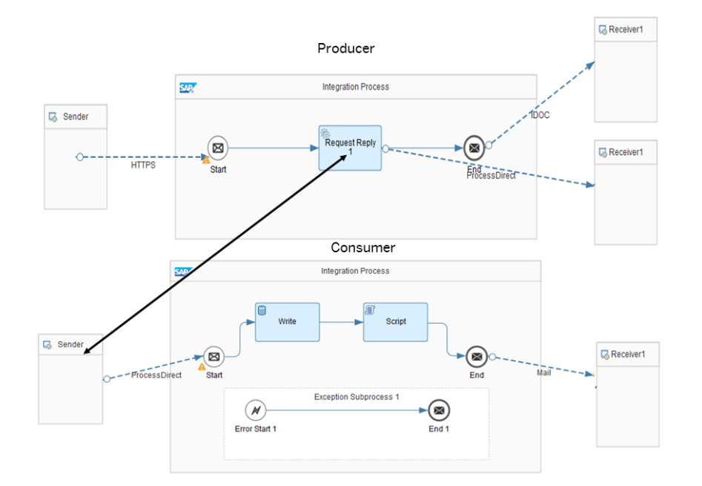
PROCESSDIRECT Adapter
The ProcessDirect adapter offered by SAP Cloud Platform Integration enables you to communicate with other integration flows deployed in your tenant without passing through the load balancer.
The usage of ProcessDirect adapter ensures that the message transmission between integration flows does not suffer from any latency issues as the message will not go through the load balancer.
Terms to keep in mind while working with ProcessDirect adapter:
Producer Integration flow:
When the ProcessDirect adapter is used to send data to other integration flow, we consider the integration flow as a Producer integration flow. This is when the integration flow has a ProcessDirect Receiver adapter.
Consumer integration flow:
When the ProcessDirect adapter is used to consume data from other integration flows, we consider the integration flow as a Consumer integration flows. This is when the integration flow has a ProcessDirect Sender adapter.
Use Case: ProcessDirect adapter is used to extend an integration flow using another integration flow provided both these integration flows should be deployed on the same tenant management node.
It should be ensured that the Address field of the ProcessDirect receiver in one Integration Flow and ProcessDirect sender in called Integration Flow are configured with the same value.

Slide 25
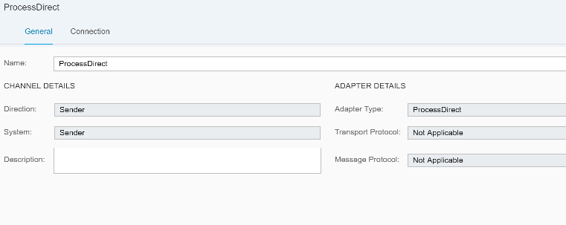
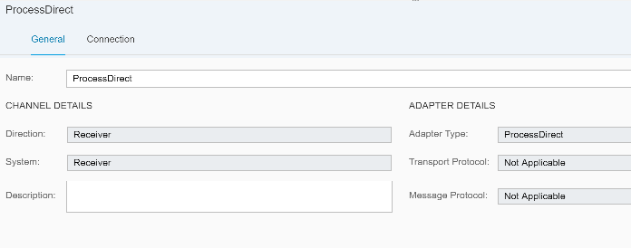
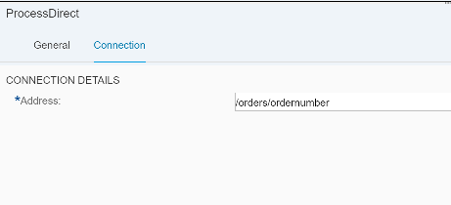
Configuration: Receiver
Configuration: Sender
Connection Details: (address starting with ‘/’ which has to be same with the producer address.)
Connection Details: (address starting with ‘/’ which has to be same with the consumer address.)

Slide 26
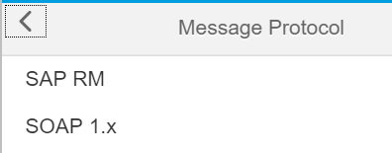
SOAP Adapter
The SOAP adapter enables you to exchange SOAP messages between remote clients or Web service servers.
Message Protocol:
SAP RM: Soap RM is used for reliable messaging between the source & target systems i.e.it maintains sequence of messages.
SOAP 1.x: SOAP 1.x describes the structure of SOAP messages, processing model and a framework for binding SOAP to underlying protocols. It allows signing & encrypting of messages as well. Exchanges messages with a sender system that supports Simple Object Access Protocol (SOAP) 1.1 or SOAP 1.2.

Slide 27
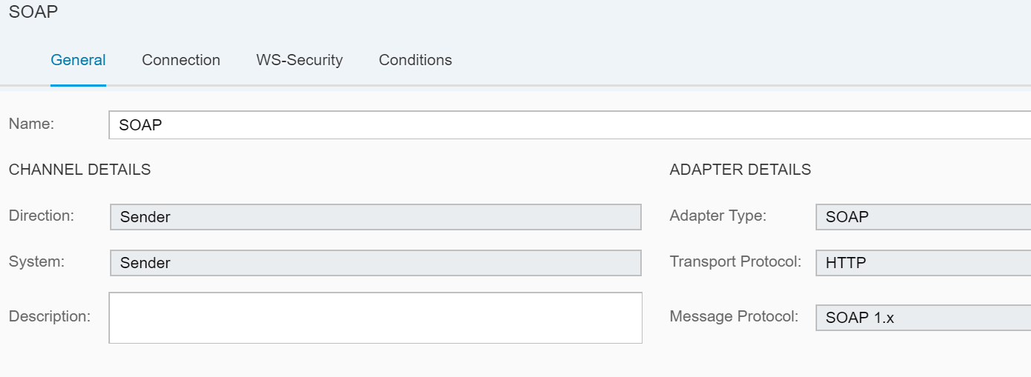
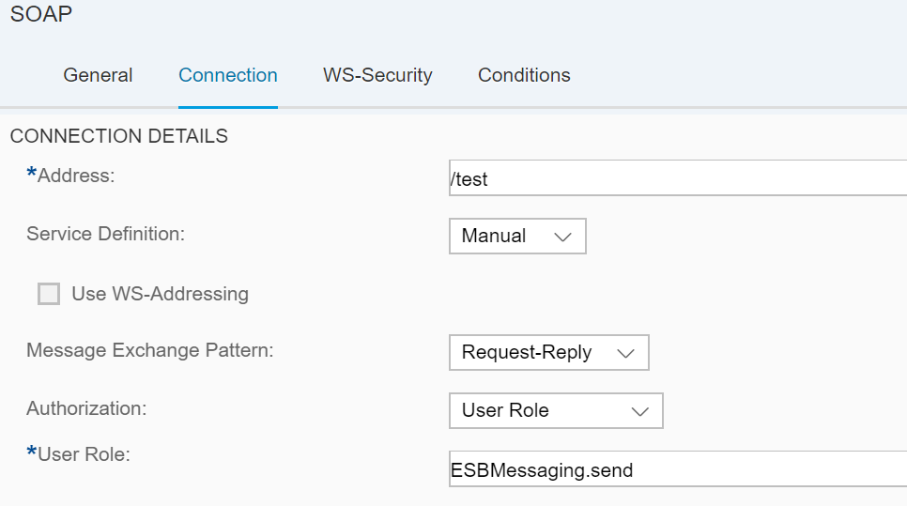
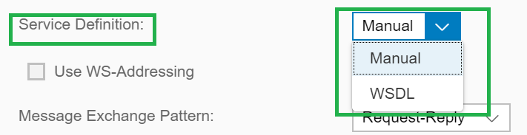
Sender SOAP Adapter:
Service Definition:
Manual: To configure the service behaviour manually.
WSDL: The service behaviour is defined via WSDL configuration.
Use WS-Addressing: This option is selected to accept addressing information from message information headers during runtime.

Slide 28
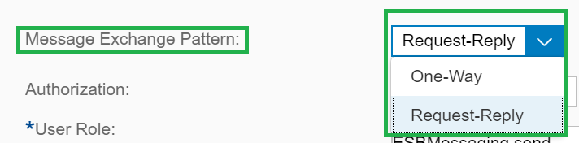
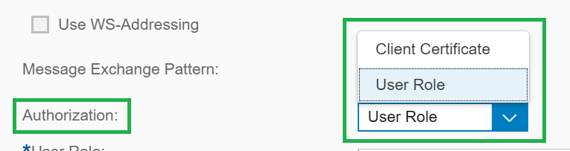
Message Exchange Pattern (MEP): •One-Way: For asynchronous/one-way communication. •Request-Reply: For synchronous requirement, where you are expecting a response from the receiver.
Configuration: Sender SOAP Adapter
Authorization:
• Client Certificate (Sender authorization is checked on the tenant by evaluating the subject/issuer distinguished name (DN) of the certificate)
• User Role (Sender authorization is checked based on roles defined on the tenant for the user associated with the inbound request.)

Slide 29
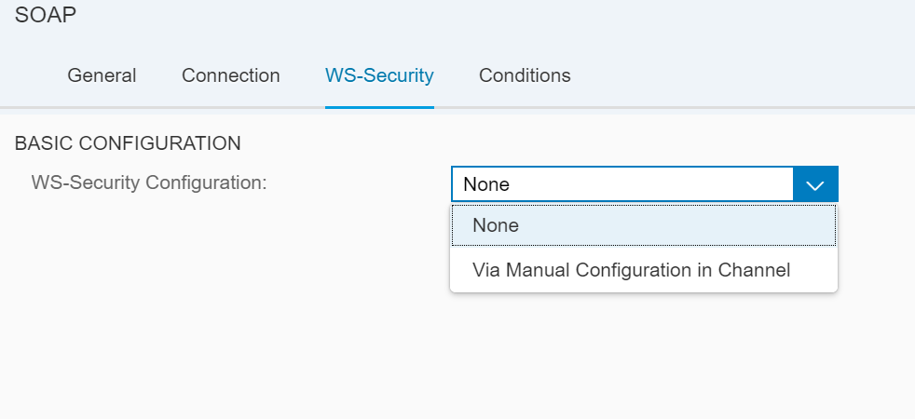
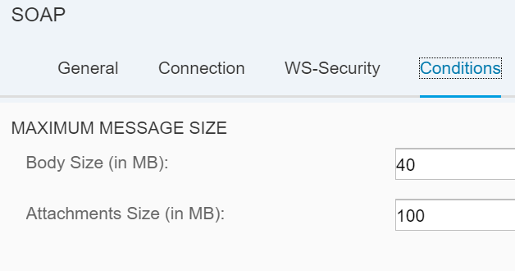
Configuration: Sender SOAP Adapter
WS-Security:
• None: No WS-Security is applied for message exchange.
• Via Manual Configuration in Channel: The security settings are manually to be configured.
Conditions:
• Body Size (in MB): It allows you to set a maximum size limit for processing inbound messages. The inbound messages which exceed the limit are rejected.
• Attachment Size (in MB): It allows you to set a maximum size limit for processing inbound attachments. The attachments which exceed the limit are rejected.

Slide 30
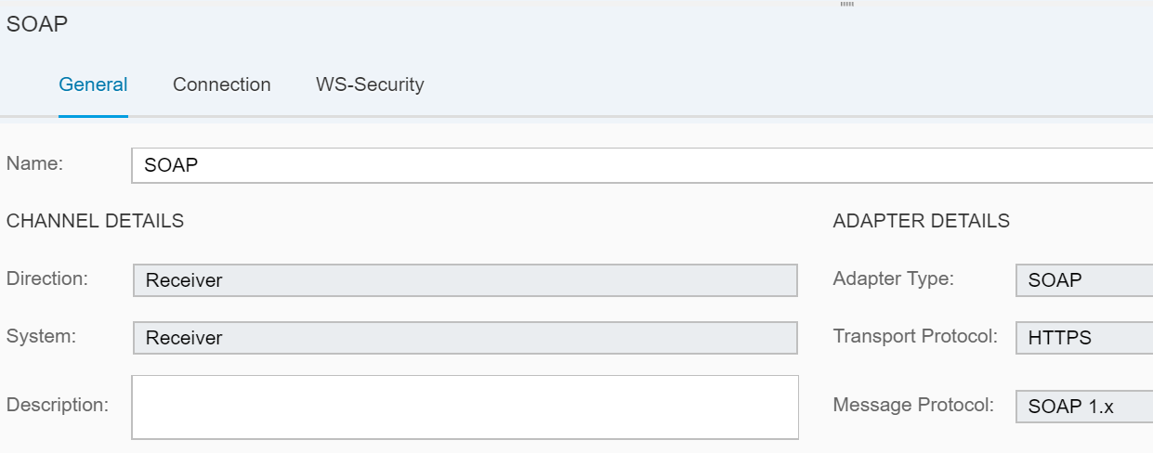
Receiver SOAP Adapter:
The SOAP adapter enables you to exchange SOAP messages between remote clients or Web service servers.

Slide 31
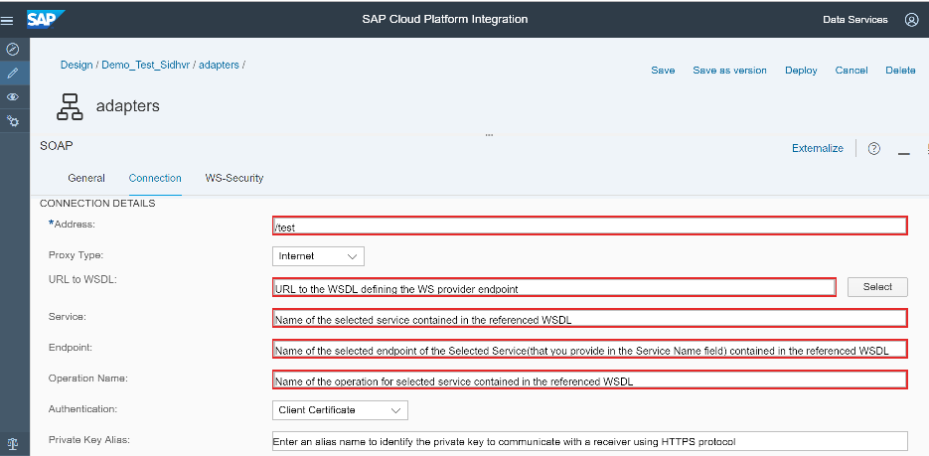
Configuration: Receiver SOAP Adapter

Slide 32
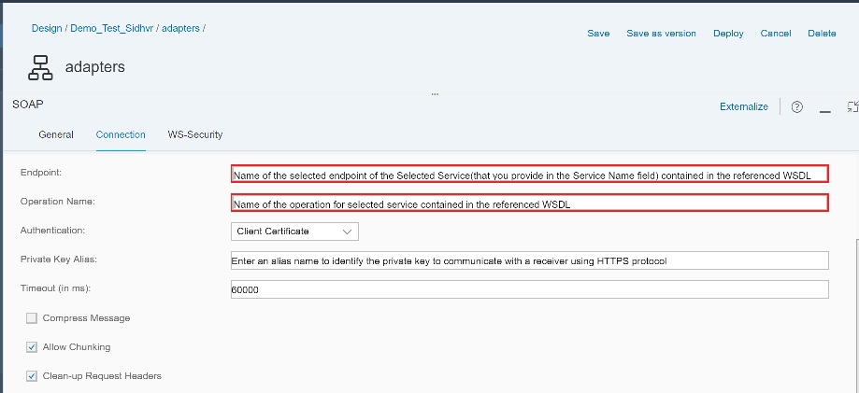
Configuration: Receiver SOAP Adapter

Slide 33
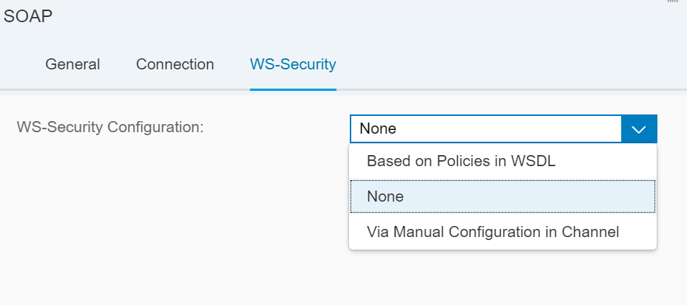
Configuration: Receiver SOAP Adapter
WS-Security:
Based on Policies in WSDL: Using this option, the security settings are specified as part of the receiver endpoint (within the endpoint WSDL) in elements as defined by the WS-Policy standard. That way you can specify, for example, within the WSDL that certificates for message level security are sent with the message.
None: No WS-Security is required.
Via Manual Configuration in Channel: Using this option, you specify the required settings in the channel. The naming of the available attributes corresponds to the terminology used in the WS-Policy specification.
Use Case: If there is a scenario to get connect to a web-service or third which supports SOAP messages, this adapters can be used. E.g.: SAP C4C can be communicated with SOAP adapter.

Slide 34
Standard Adapters used in SAP CPI
Success Factor Adapter :
As a Sender Channel when you would like to poll the SuccessFactors system at regular intervals and Query data from the system. When using the SuccessFactors Adapter as a Sender channel only Query operation is available and
Ariba Adapter :
Used to enable the SAP and non-SAP cloud applications to send and receive business-specific documents in cXML format to and from the Ariba Network.
Facebook Receiver Adapter:
Used to extract information from Facebook (which is the receiver platform) based on certain criteria such as keywords, user data.
Twitter Adapter :
Used to extract information from the Twitter platform based on certain criteria such as keywords, user data, the tenant (through the Twitter receiver adapter) calls the Twitter API to access resources of a specific Twitter user.

Slide 35
QUESTIONS!!!!

